Slide 1
Video Project
https://www.youtube.com/watch?v=Ob8Z-iLV5KY

Slide 2
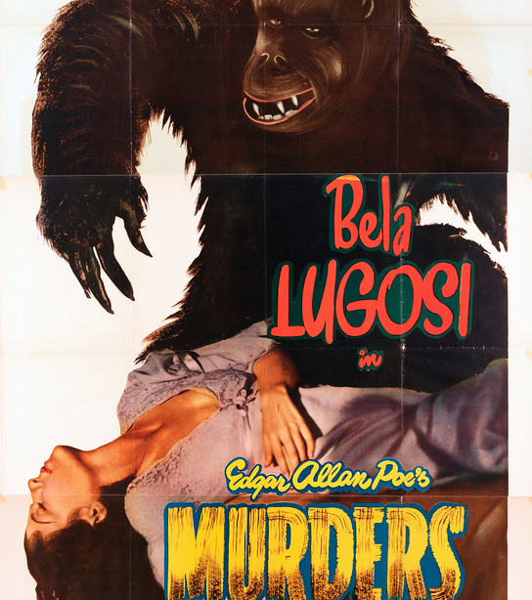
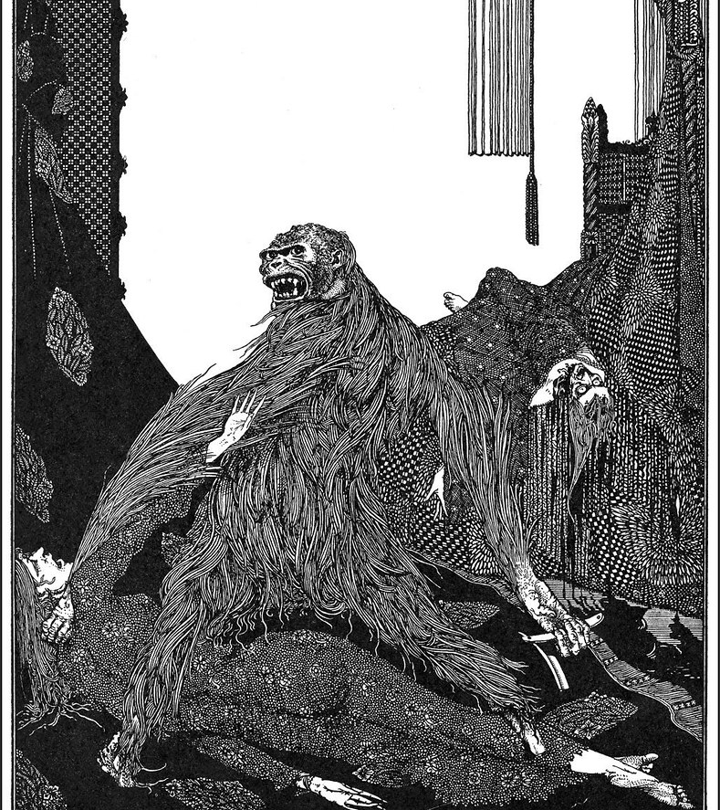
The Ken Burns Effect
-Used to emphasize content and create continuity
-Transition of images closely follows the narration to further illustrate what is being said.
-The actual movement over images serves to highlight the emotional tone of the content
-No actual depictions of Poe

Slide 3
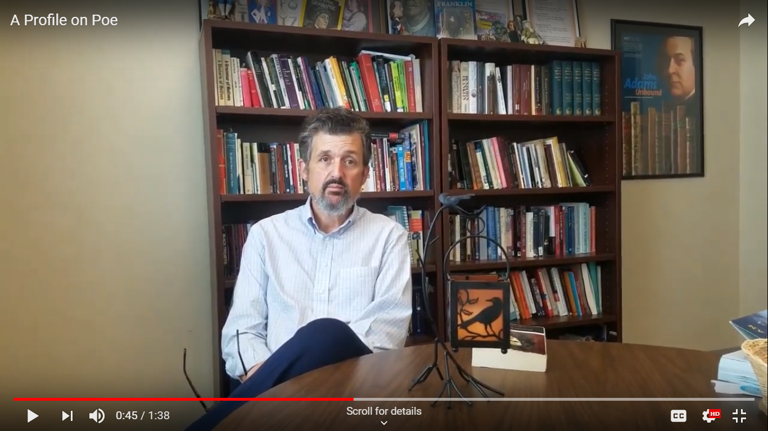
Interview
-Natural lighting was available – I was able to position Dr. Curtis so that the light would highlight half of his face, creating both definition and shadow
-Medium shot used to accentuate the bookshelf and create a familiar environment
-Poe props were a silly way to reinforce theme and credibility.

Slide 4
Final Shot:
-Portrait used instead of photograph because it is human and evocative
-Only image of Poe where he is not disguised by or costumed in his work – reinforces conclusion

